Slide 1
Cats vs Dogs Detector (CaDoD) Phase 2
Group 19
Aishwarya Sinhasane, Himanshu Joshi
Sreelaxmi Chakkadath, Sumitha Vellinalur Thattai

Slide 2
Agenda
Agenda
Past – Phase 1
Present – Phase 2
Homegrown CXE + MSE Loss
Multi Layered Perceptron (MLP)
Multi headed MLP
Results and Discussion
Conclusion & Next Steps

Slide 3
Past - Phase 1
Past
Performed EDA and rescaled the data set
Built various models for image classification for boundary detection
Baseline model:
Image classification - Gradient boosting
Boundary detection - Linear regression

Slide 4
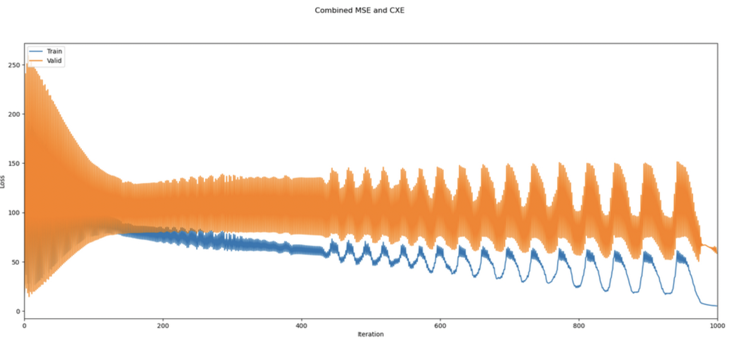
Phase 2 - Homegrown CXE + MSE
Homegrown Model
Homegrown Models
We have implemented a logistic and linear regression from scratch
Elastic net (L1 and L2) was added to the homegrown model to decrease the MSE
Implemented functions to find log loss for classification and MSE for regression
Complex function
We have defined a function which will combine the log loss of the logistic regression and MSE of the linear regression

Slide 5
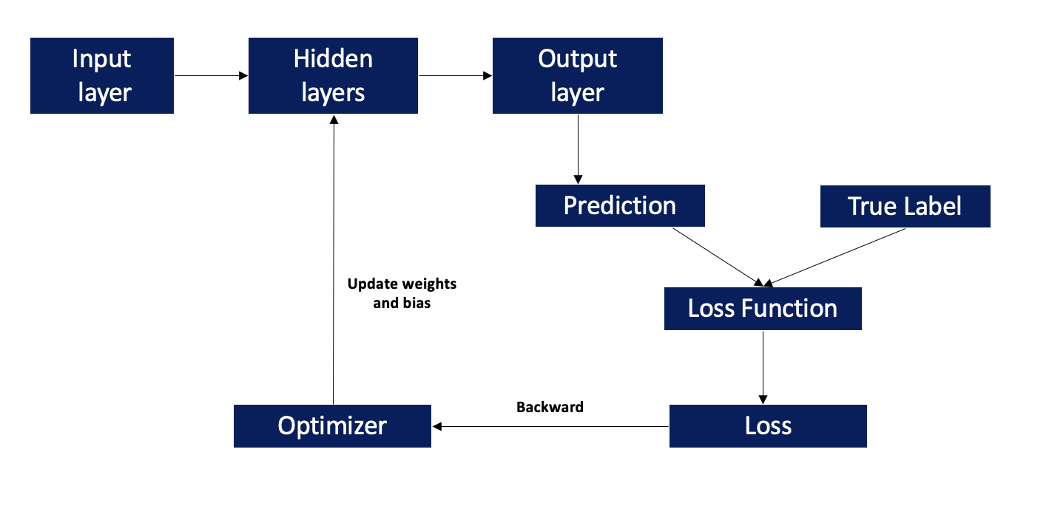
Multi-Layered Perceptron
Multi-Layer Perceptron
Built a neural network using sequential and OOP API in Pytorch
Layers Used:
Input Layer
2 hidden layers
Activation function – ReLU for classification and tanh for regression
Dropout layer
Output layer
Loss functions used:
Cross Entropy – for classification; MSE – for regression
Optimizer - Adam

Slide 6
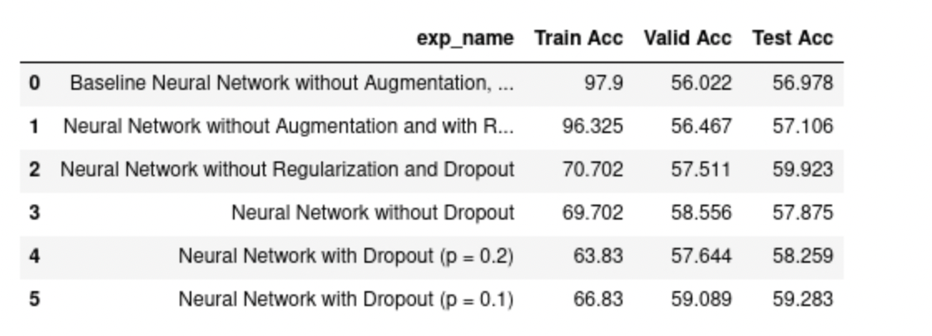
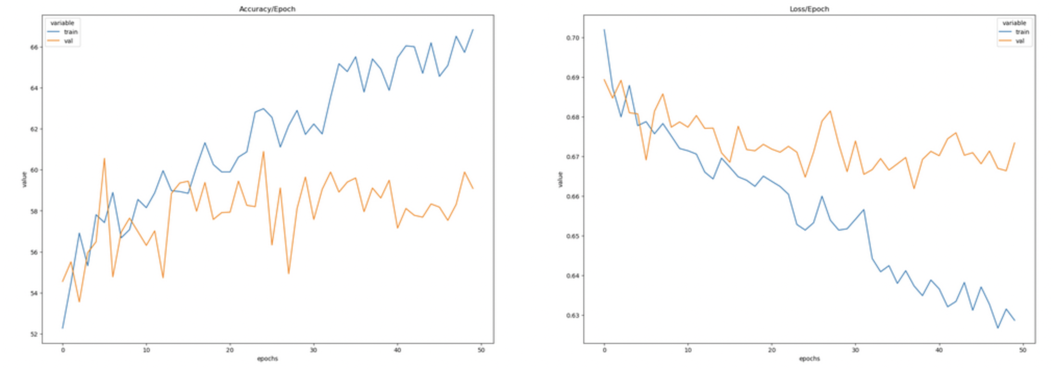
Sequential Classifier For Image Detection
Results and Discussion
NN without augmentation overfits the data; training accuracy is very high, whereas the validation accuracy dropped to almost half
Validation accuracy was improved by: Augmenting data, Adding dropout layer, and Regularization
Accuracy and Loss graph for neural network with dropout layer (p = 0.1)
Optimizer – Adam; Loss function – Cross Entropy

Slide 7
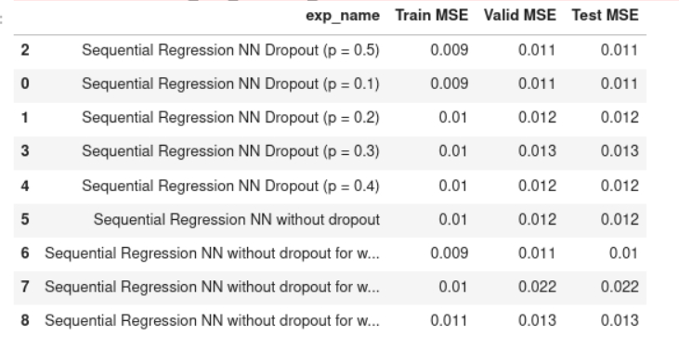
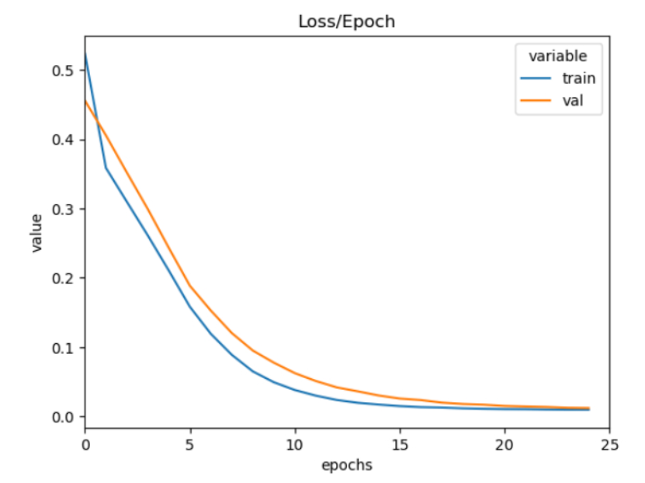
Sequential Regressor For Boundary Detection
Results and Discussion
Graph for neural network with dropout layer (p = 0.1)
We see that loss is decreasing after every epoch for training and validation set
Also, there was not a huge difference in the MSE value after adding a drop out layer
Optimizer – Adam; Loss function - MSE
Results in the next slide

Slide 8
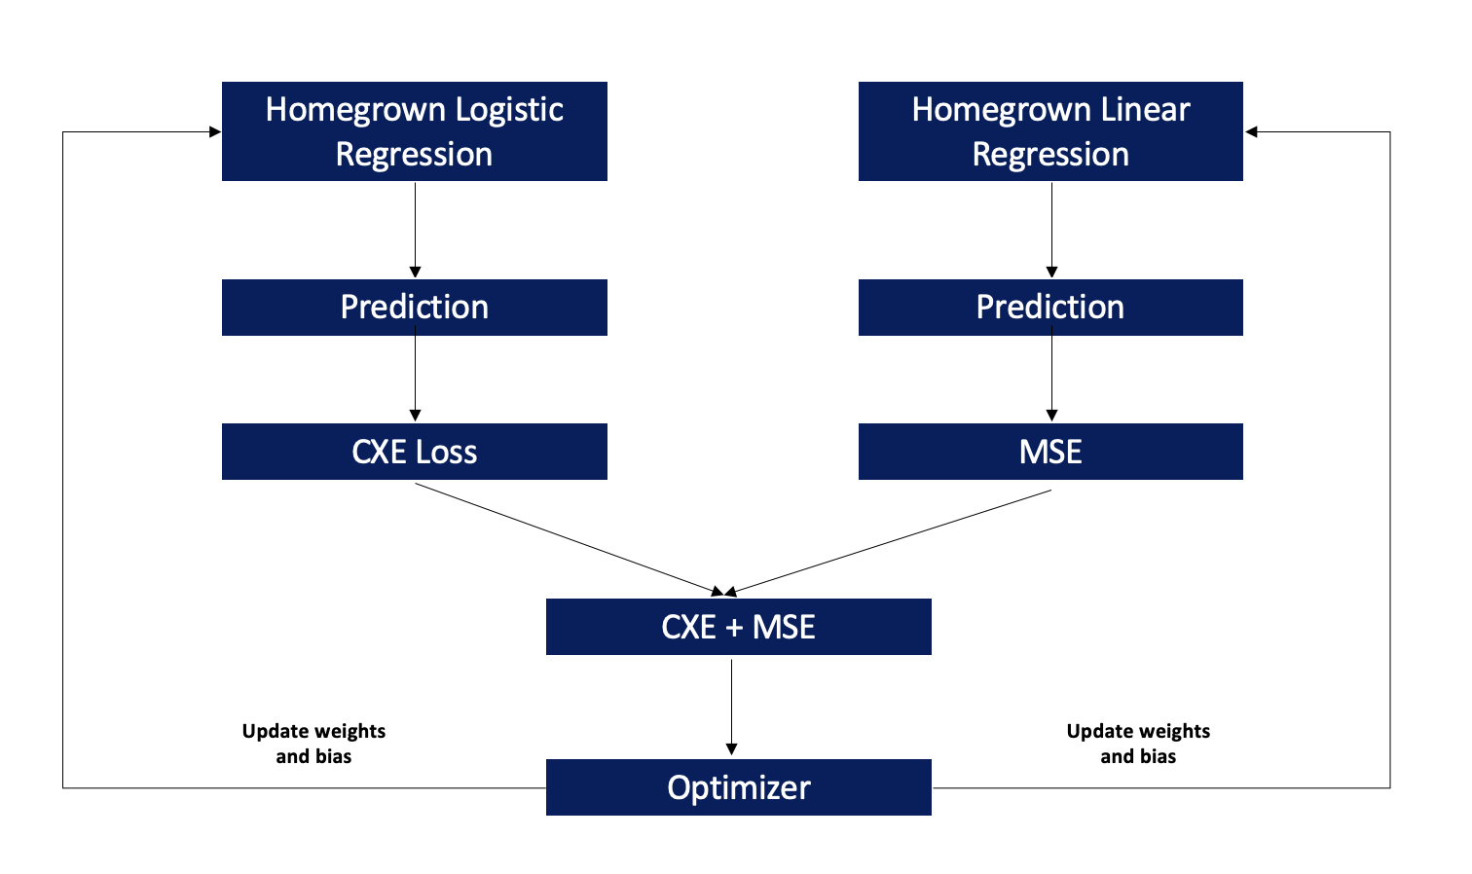
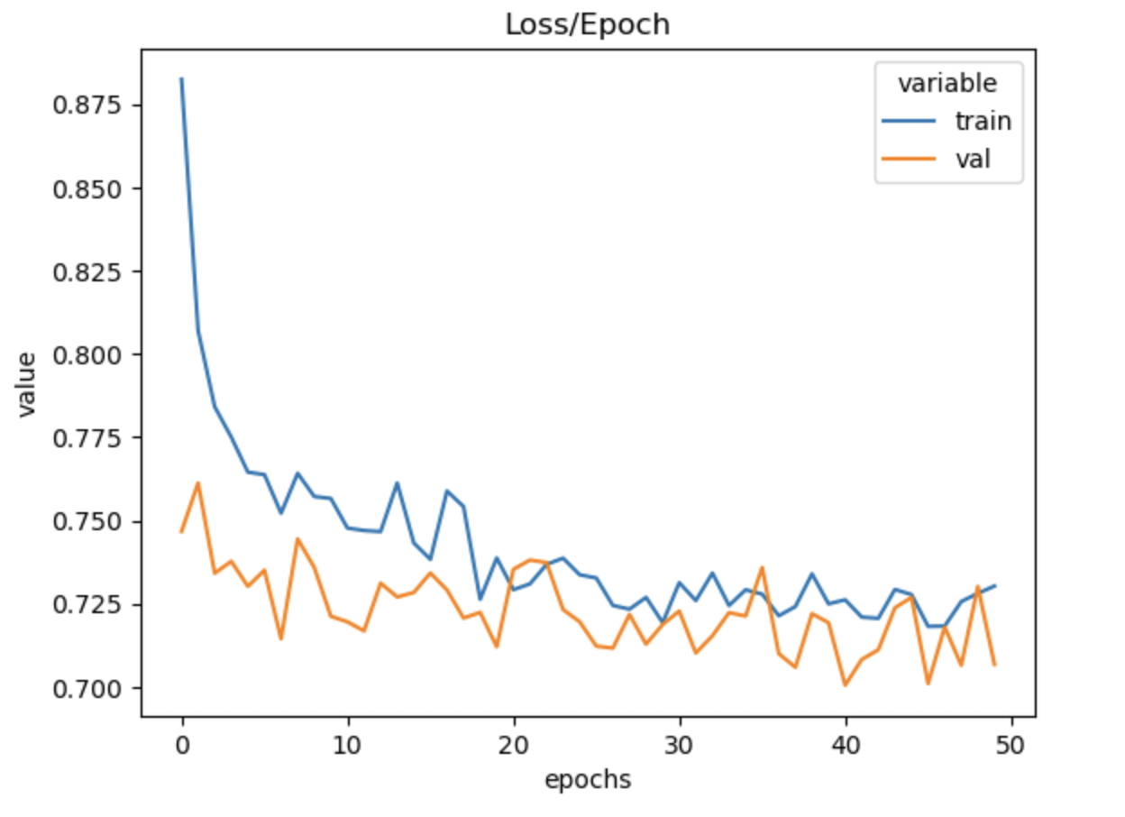
Complex Loss Function – CXE + MSE
Neural Networks
CXE from classifier model and MSE from regressor model was combined and sent as a feedback to optimize the model
We see that both training and validation loss are decreasing at each epoch

Slide 9
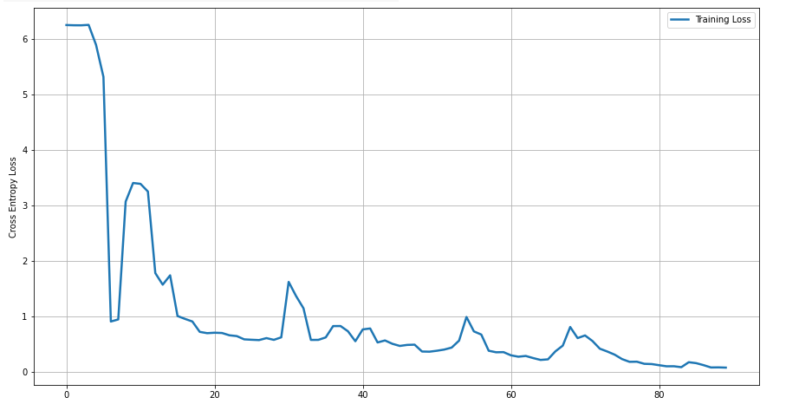
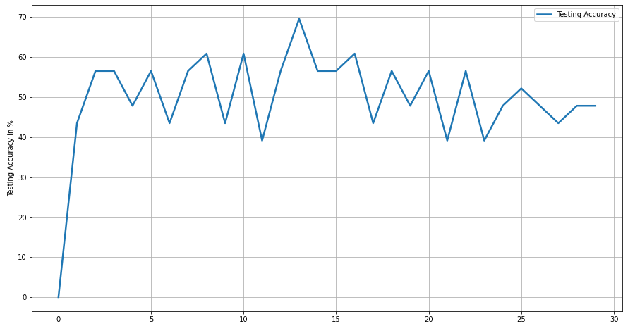
Convolution Neural Network
Results and Discussion
Used a maxpooling layer to reduce the number of feature maps
Used a softmax function in the output layer as an activation function
Learning rate= 0.01, momentum=0.3
Mini batch size = 30
Optimizer - SGD; Loss function – Cross entropy
Results will be directional (and not very accurate) since it is based on only 2500 data points

Slide 10
Conclusion & Next Steps
Next Steps
Conclusion
NN with augmentation, dropout layer and regularization helped us overcome overfitting and increase the accuracy to ~60%
Loss reduced at each epoch for both train and validation set
Next Steps
Optimize the current CNN by experimenting with data augmentation, different optimizers, learning rates, and weight delays
Building a Transfer learning model using EfficientDet
Perform a t-test to compare the different models with this transfer learning model

